Slide 1

The
Project work
on
Energy Generation through Rain
Under the esteemed guidance of
Mrs. Shilpa B. Darvesh M.Tech, (Ph.D)
Assistant Professor
By
K. Manish 1608-23-735-089
K.Swetha 1608-23-735-090
J. Rohini 1608-23-735-310
Department of Electronics and Communication Engineering
(NBA Accreditation)
MATRUSRI ENGINEERING COLLEGE
(Sponsored by Matrusri Education Society, Estd1980)
(Approved by AICTE, Affiliated to Osmania University)
#16-1-486, Saidabad, Hyderabad, Telangana-500 059
www.matrusri.edu.in
2025-26

Slide 2
Contents:
Introduction
Problem statement
Literature survey
Objective
Major components
Core Concept
Key Components
How it works
Need for unconventional power
Advantages
Conclusion
References

Slide 3
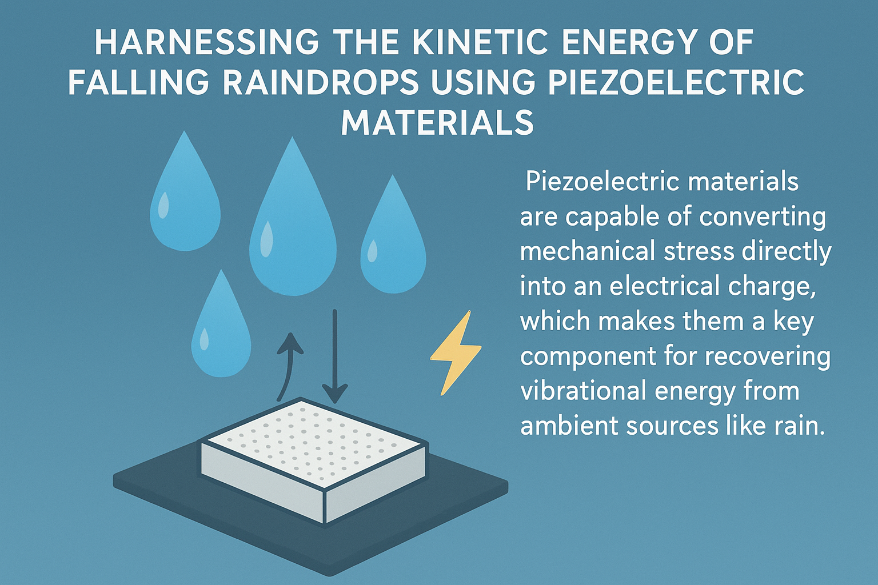
Introduction:
The global energy crisis and the pressing need for sustainable energy alternatives have spurred innovation in the field of renewable energy harvesting. Like from Wind, Water, Sun, etc.
This project investigates an approach to generate power by harnessing the kinetic energy of falling raindrops using the piezoelectric effect.
Piezoelectric materials are
capable of converting
mechanical stress directly into
an electrical charge, which
makes them a key component
for recovering vibrational
energy from ambient sources
like rain.

Slide 4
Problem statement:
The growing global dependence on electrical power and the rise in severe weather events expose a critical flaw in conventional energy infrastructure.
During heavy, continuous rainfall, frequent power outages occur, leaving essential services without electricity.
Existing renewable energy like solar is severely limited under these conditions, creating an "energy generation gap" when reliability is crucial.
The core problem is the absence of a reliable, localized, complementary power source that can harvest energy during intense rainfall and grid failures.
This project proposes a novel system to convert the kinetic energy of falling raindrops into usable electricity to address this vulnerability.

Slide 5
Literature Survey:
Piezoelectric water drop energy harvesting
(AI Ahmad - Journal of electronic materials, 2014 - Springer)
Harvesting raindrop energy with piezoelectrics
CH Wong, Z Dahari,A Abh Manaf…- Journal of Electronic…,2015 - -Springer
Next-generation rooftop tribo-piezoelectric energy harvesting from rain power
(SP Rajeev, SK John, R Cherian, SC Karumuthil…- Applied…,2020 - Springer)

Slide 6
Objective:
The main objective of energy generation through rain piezoelectric systems is to harvest ambient kinetic energy from falling raindrops and convert it into usable electrical energy.
This electricity can then be stored (typically in rechargeable batteries) or used to power small-scale electronic devices and systems.

Slide 7
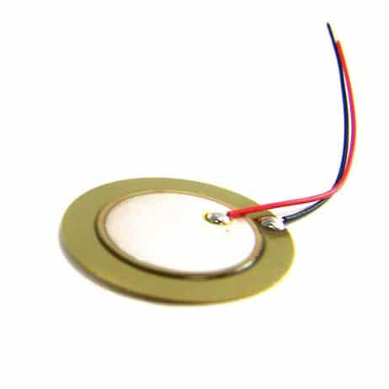
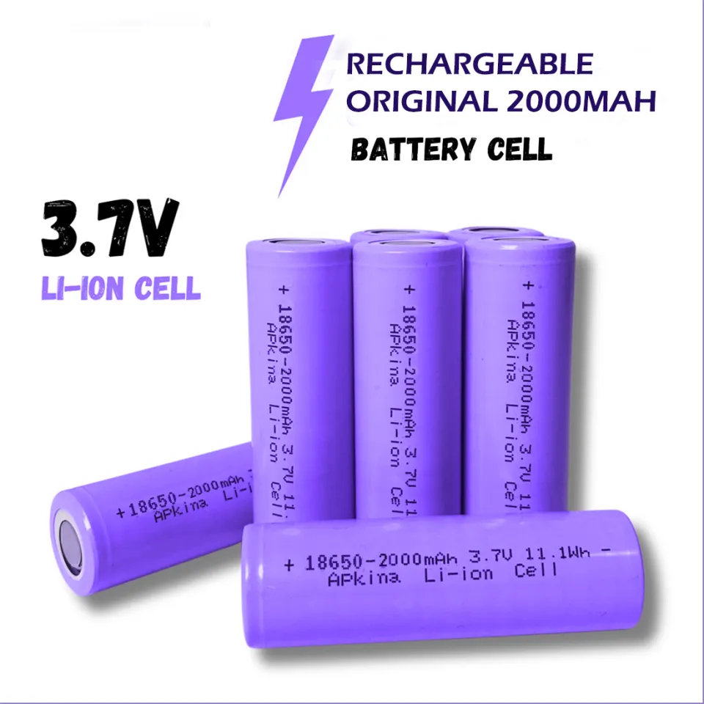
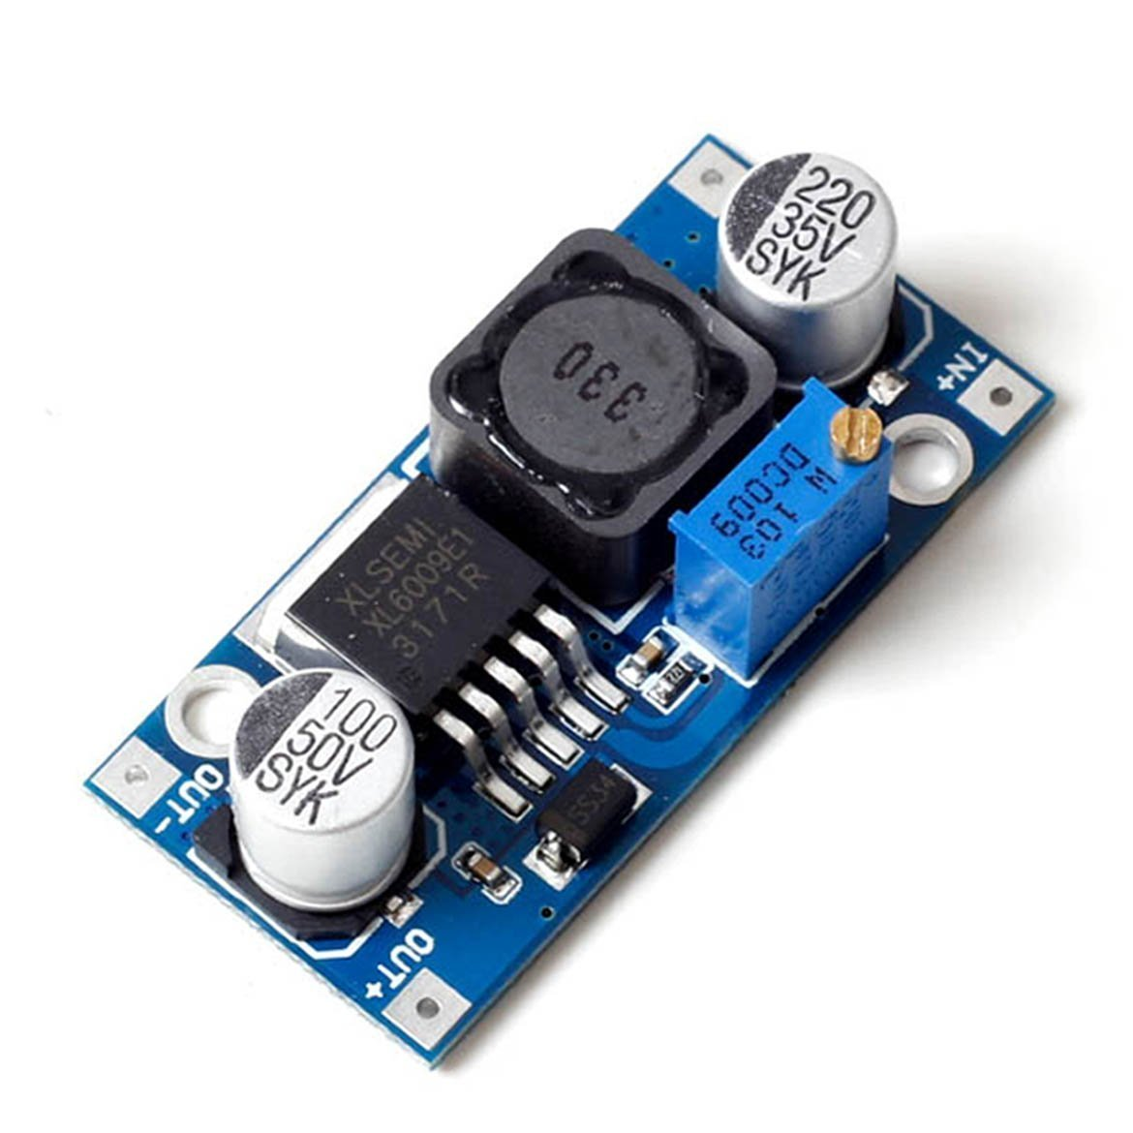
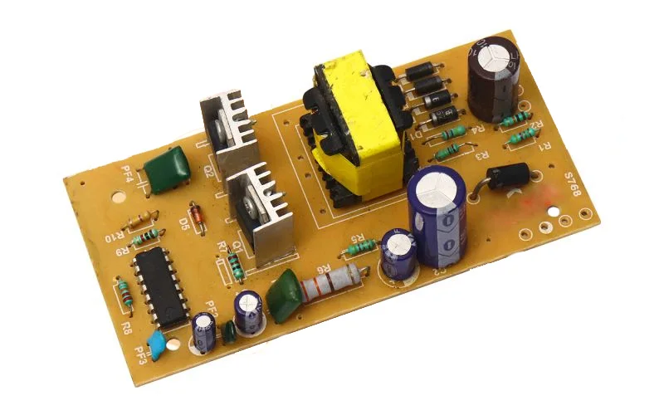


Hardware Components:
Piezoelectric Transducer
Lithium ion Battery
Voltage Booster Module
DC to AC Converter
Mini Voltage Meter
DC Water Pump

Slide 8

Project Goal:
Kinetic
Energy
Electrical
Energy

Slide 9
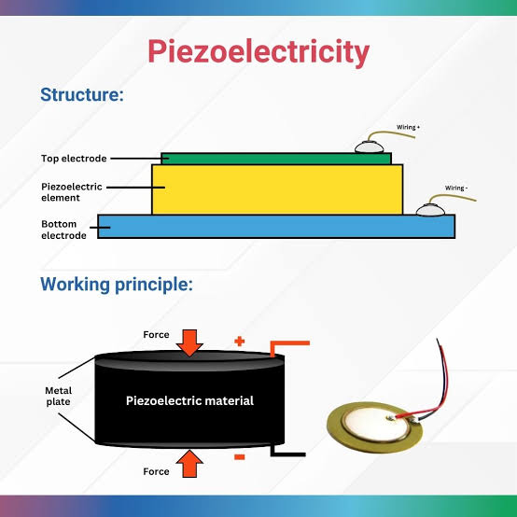
Key Component:

Slide 10
Key Component:
The Piezoelectric Effect
This is the fundamental principle enabling our project. Piezoelectric materials-certain crystals or ceramics-possess the ability to generate an electric charge in direct response to applied mechanical stress or pressure.
In our system, the vibrations and pressure pulses from the sheet's deflection are the critical mechanical input that drives the entire energy harvesting process.

Slide 11
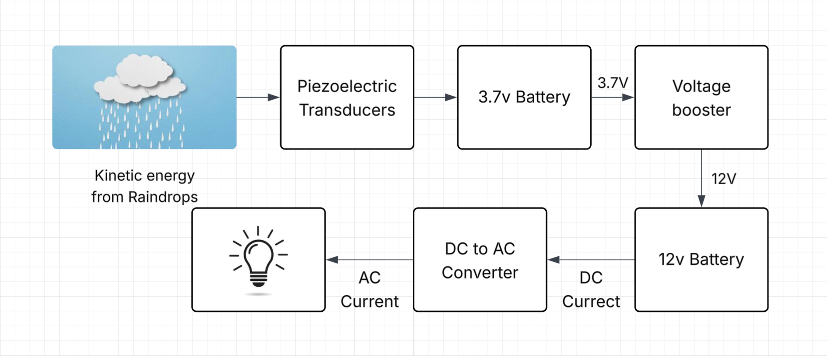
Block Diagram:

Slide 12
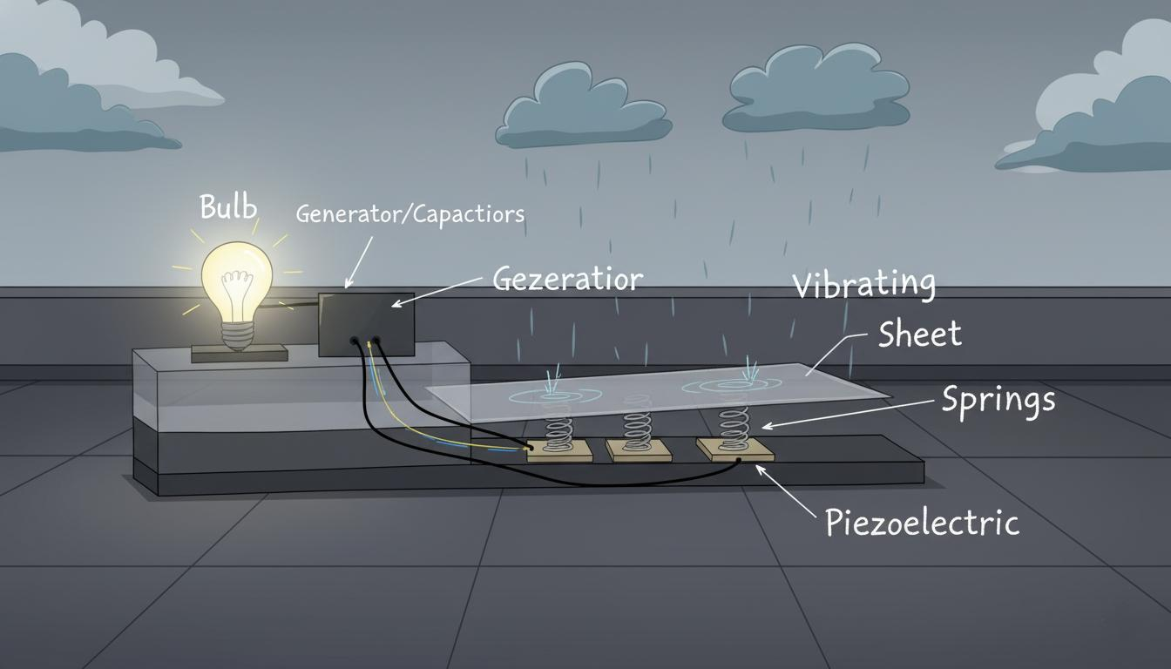

Slide 13
How it works:
Raindrops strike the sheet placed on rooftop.
The kinetic energy due to rain, makes the sheet vibrate, resulting in pressing the Piezoelectric Transducers.
When piezoelectric transducers are struck with some force, they generate a small amount of electricity.
The power generated by piezoelectric transducers will be stored in a capacitor or some battery.
That stored electricity is used in small household applications.

Slide 14
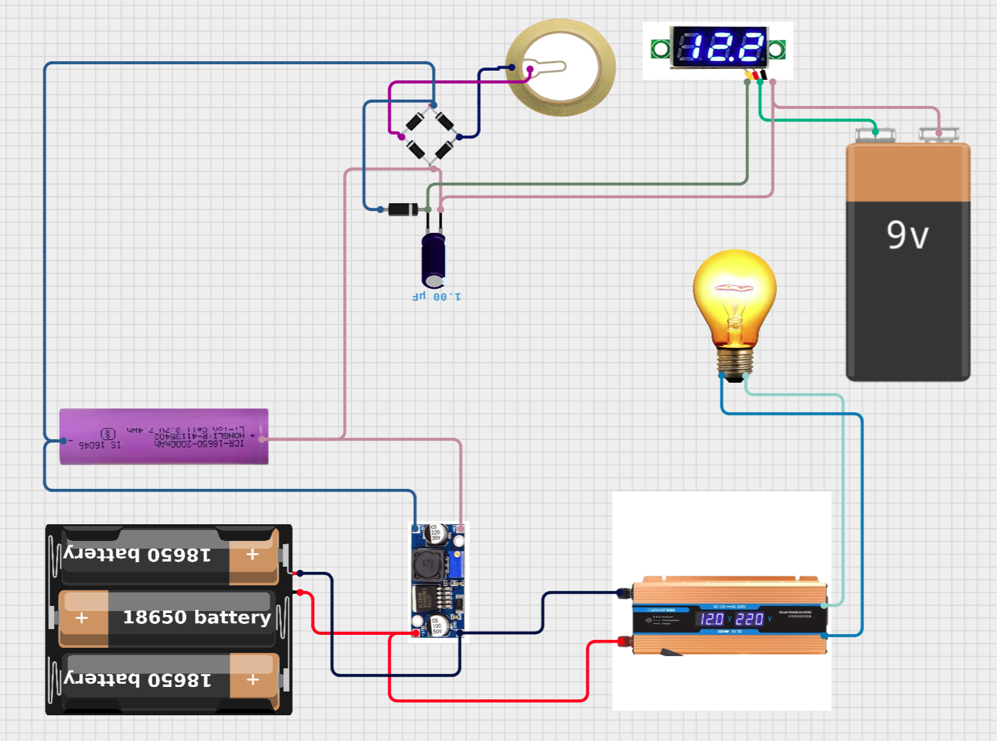
Schematic Diagram:

Slide 15
Need For Unconventional Power:
♻️Environmental Responsibility: Provides an eco-friendly alternative to disposable batteries, reducing electronic waste and associated environmental impact.
🌧️Untapped Resource: The kinetic energy from rainfall is a massive, widely distributed, and consistently overlooked resource, especially in high-precipitation regions.
📌Passive and Complementary: Unlike solar or wind, this system generates energy in low-light, wet conditions, making it an excellent, complementary micro-grid solution.

Slide 16
Advantages of The Design:
Scalability & Modularity
The design is fully modular, allowing for easy expansion and installation on any size of terrace, rooftop, or outdoor structure without major architectural changes.
Passive & Autonomous
The system requires no external power or active management. It operates autonomously whenever precipitation occurs, making it a truly "set-and-forget" energy source.
Low Maintenance
With a simple, robust mechanical structure (sheet, springs, fixed piezoelectrics) and few moving parts, the system promises high longevity and minimal maintenance requirements.

Slide 17
Conclusion:
This project successfully validates the core concept of harvesting kinetic energy from rainfall using a piezoelectric-based system.
We have demonstrated a viable, passive, and scalable method for microgeneration, capable of powering low-demand electronics like LEDs.
Future work will focus on materials optimization (e.g., more sensitive piezoelectric composites) and advanced power conditioning to improve efficiency.
With refinement, this technology can power a new generation of autonomous sensors, small devices, and safety lighting, contributing to global green energy solutions.

Slide 18
Reference:
Harvesting Energy from Rainfall (Aashay Tinaikar, 2013, et al.)
Published in the International Journal of Renewable and Sustainable Energy.
Regenerating energy through the rainwater down piping system
(Muhamad Arfauz A. Rahman, et al., 2019)
Rain Power: Droplet-Based Energy Generator Lights Up 100 LEDs
(Published in Nature, 2020)
Implementation of rain power generation using circular piezoelectric (ResearchGate, 2025)

Slide 19
Thank you!

